Slide 1
DATA MODELS
Conceptual Data Model
Representational Data Model
Physical Data Model
Hierarchical Model
Network Model
Object-Oriented Data model

Slide 2
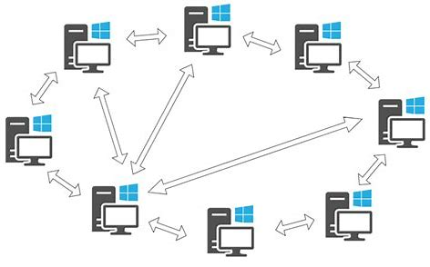
NETWORK MODEL
In this type of model, a child can be linked to multiple parents, a feature that was not supported by the hierarchical data model. The parent nodes are known as owners and the child nodes are called members.

Slide 3
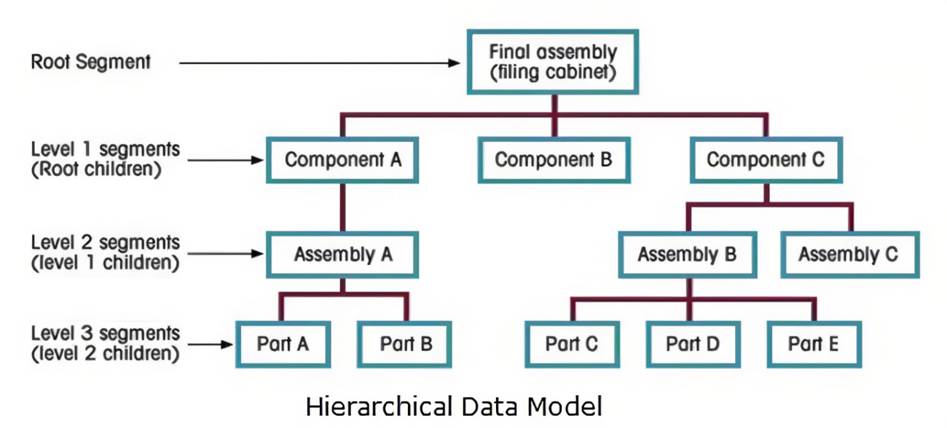
Hierarchical Database Model
A hierarchical data model was one of the earliest data models. This model was a file based model build like a tree. In this tree, parent could be associated to multiple child nodes, but a child node could have only one parent.

Slide 4
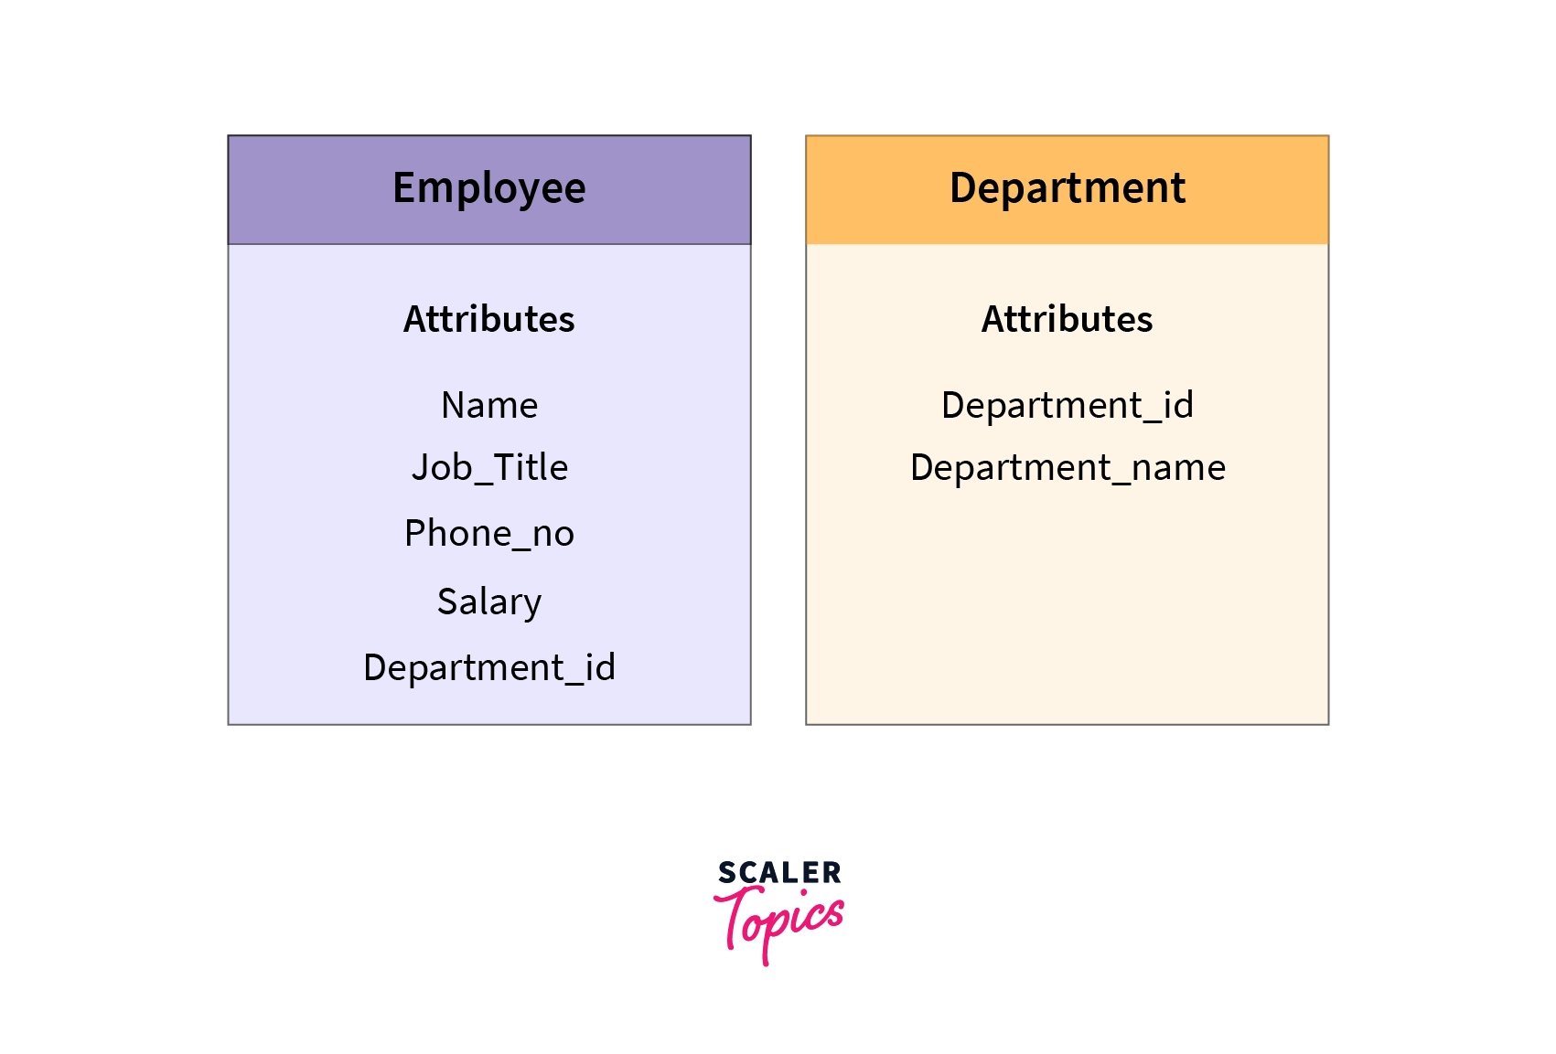
Object-Oriented Data model
As suggested by its name, the object-oriented data model is a combination of object-oriented programming and relational data model. In this data model

Slide 5
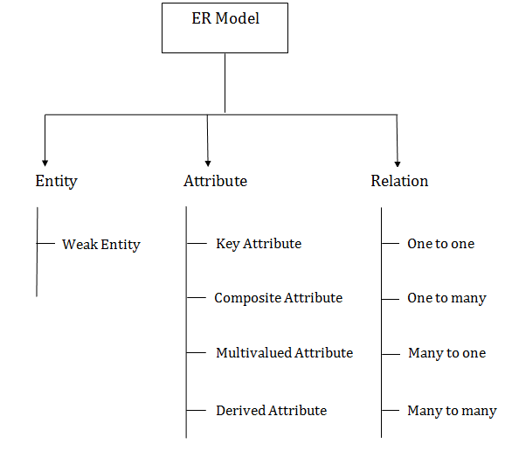
Component of ER Diagram

Slide 6
